Slide 1
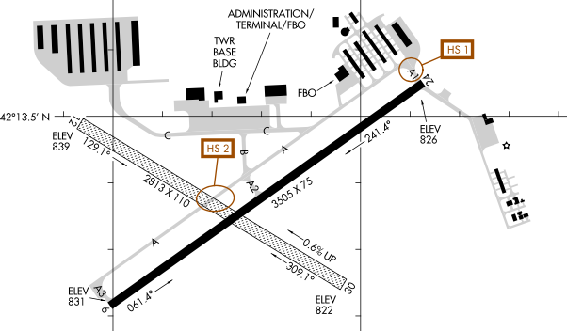
AA1
C1
A1_24
BC
AC
AB
A2_6
AA3
A3_6
Naming convention: Intersections are named by concatenating the names of the 2 taxiways that intersect at that point, in alphabetical order. If there are more than 2 taxiways intersecting there, choose 2 ”major” taxiways to use to name the intersection. Nodes at runways are named by appending “_[runway number]” to the name of the taxiway which intersects the runway, with runway number chosen as the number of the closest end of the runway to that taxiway. Nodes at hangars/parking areas are the taxiway name plus a unique suffix.

